Slide 1


Slide 2
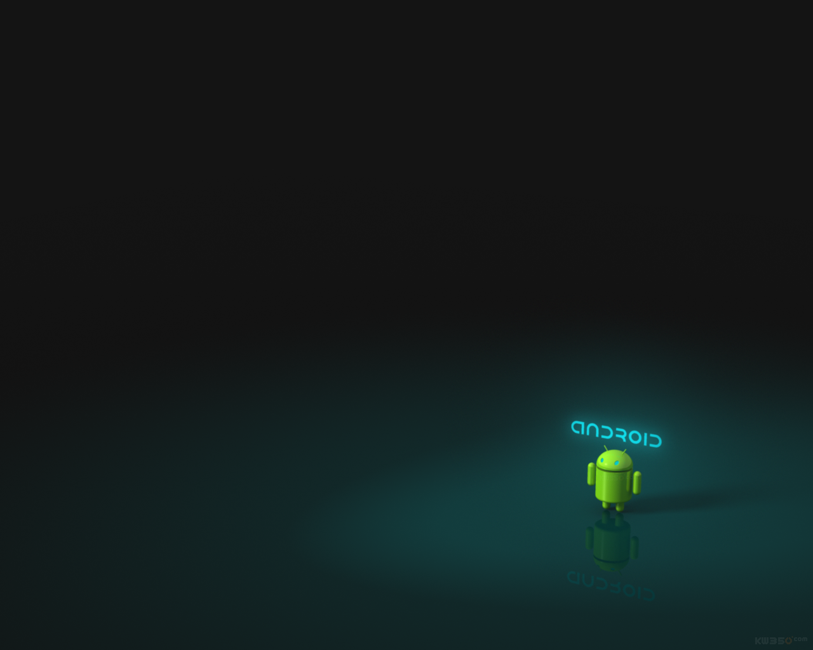

APPS ICON

Slide 3


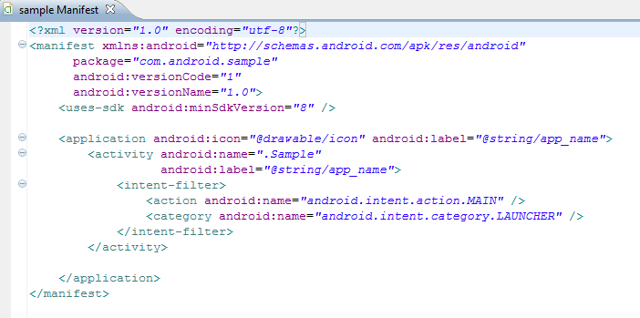
Changing the apps icon image:
To change the image of your apps icon simple follow these steps:
1. In Eclipse, open the AndroidManifest.xml file.
2. Look for an image or picture that you want your apps to have. (ideal size is 48x48). Then place it in the drawable folder/s of your Activity.
3. Edit the line <application android:icon="@drawable/icon“ and change the “icon” into the file name of the new image that you want. Save and Test.

Slide 4
PACKAGING

Slide 5
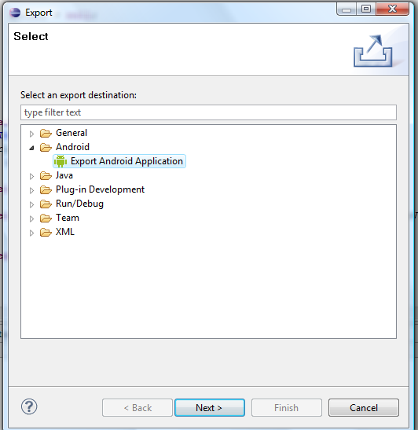
Exporting and Signing the Package File
To export and sign your Android package file using the wizard provided as part of the Eclipse plug-in, perform the following steps:
1. In Eclipse, right-click the appropriate application project and choose the
Export option.
2. Under the Export menu, expand the Android section and choose Export
Android Application.
3. Click the Next button.

Slide 6
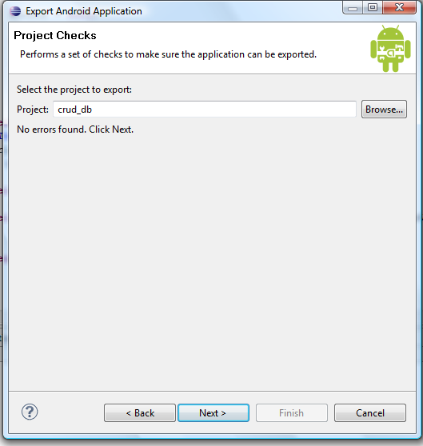
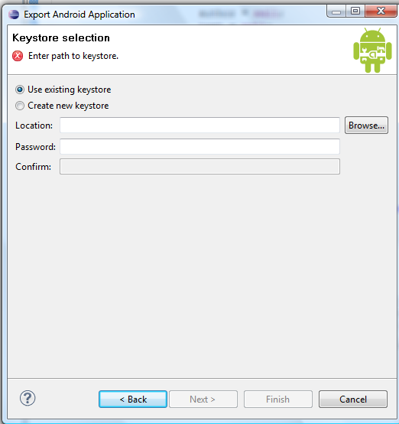
4. Select the project to export. (The one you right-clicked before is the default.)
5. On the keystore selection screen, choose the Create New Keystore option and enter a file location (where you want to store the key) as well as a password for managing the keystore. (If you already have a keystore, choose browse to pick your keystore file, then enter the correct password.)

Slide 7
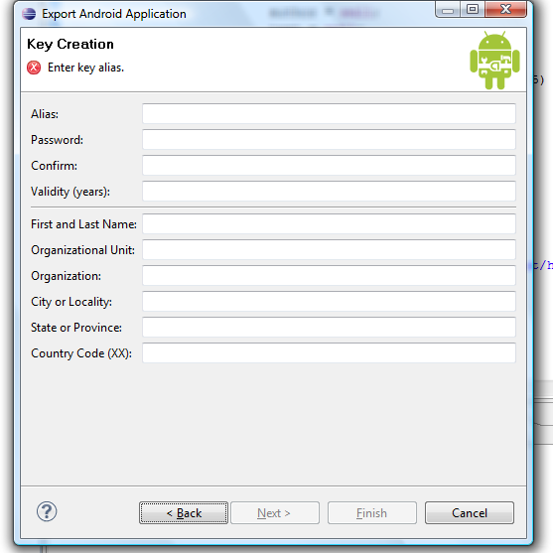
6. Click the Next button.
7. On the Key Creation screen, enter the details of the key, as shown :
8. Click the Next button.
9. On the “Enter destination and key/certificate checks” screen, enter a destination
for the application package file.
10. Click the Finish button.
You have now created a fully signed and certified application package file.

Slide 8
Signing Up for a Developer Account

Slide 9
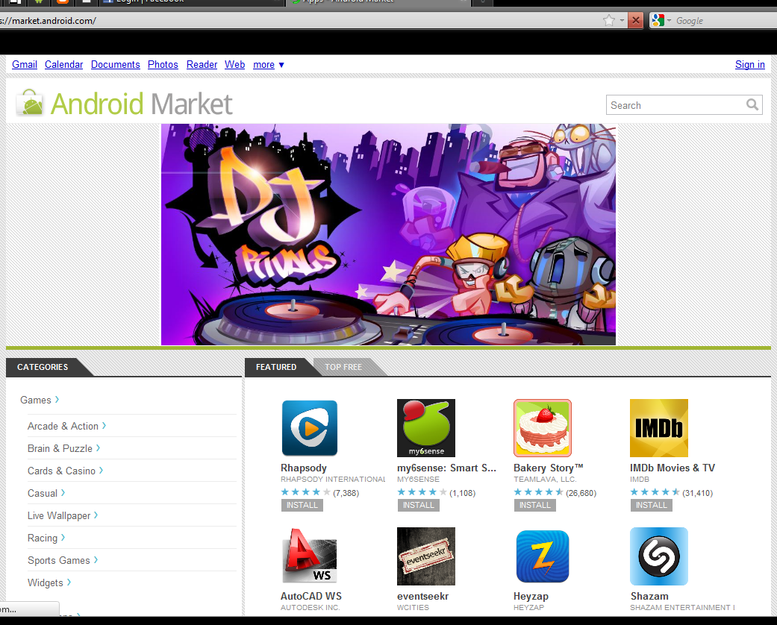
Signing Up for a Developer Account
To publish applications through the Android Market, you must register as a developer. Registering as a developer verifies who you are to Google and signs you up for a Google Checkout account, which the Android Market uses to disperse revenue from applications sales back to developers.

Slide 10
Signing up for Google Market:

Slide 11
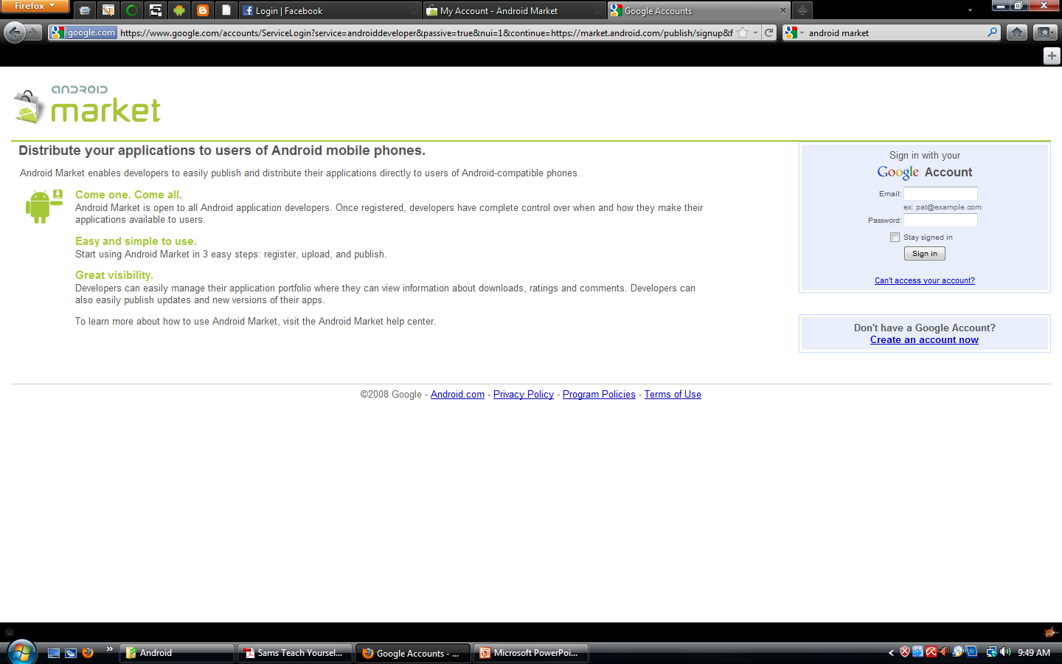
Steps in signing up for Google Market:
1. Browse to http://market.android.com/publish/signup, as shown below:
2. Sign in with the Google Account you want to use.

Slide 12
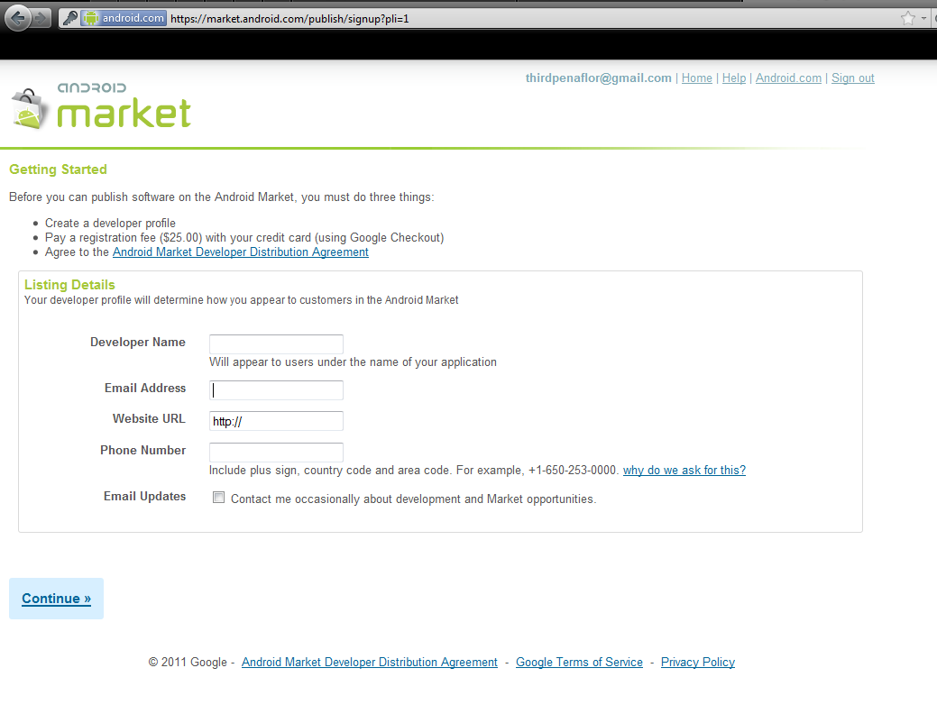
3.Enter you developer information, including your name, email address, and website, as shown:
4. Confirm your registration payment (as of this writing, $25 USD). Note that
Google Checkout is used for registration payment processing.
5. Provide information for a Google Checkout Merchant account. This is mandatory
when signing up and paying to be an Android Developer.

Slide 13
6. Agree to link your credit card and account registration to the Android Market
Developer Distribution Agreement.
When you successfully complete these steps, you are presented with the home screen
of the Android Market, which also confirms that the Google Checkout Merchant
account was created.

Slide 14
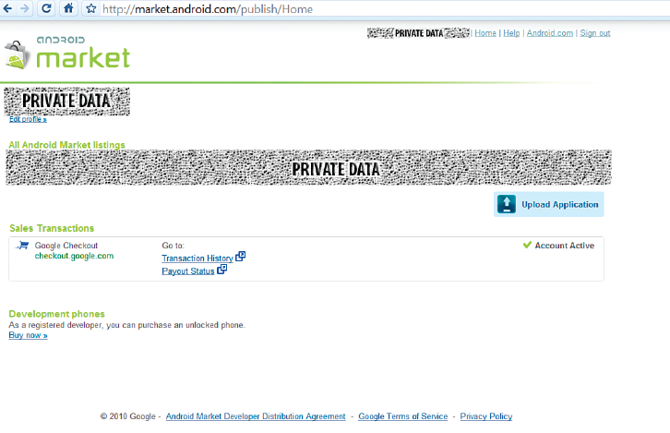
Uploading an Application to the Android Market
Now that you have an account registered for publishing applications through
Android Market, you are ready to upload applications package. From
the main page of the Android Market website, sign in and click the Upload
Application button, as shown below.

Slide 15
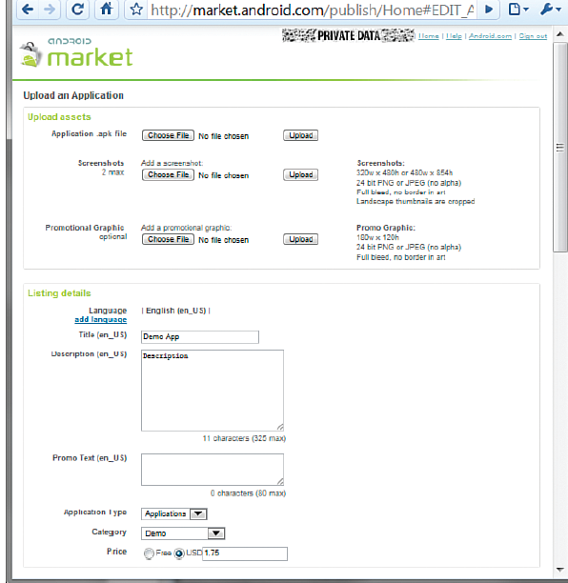
The form for uploading the application package.

Slide 16
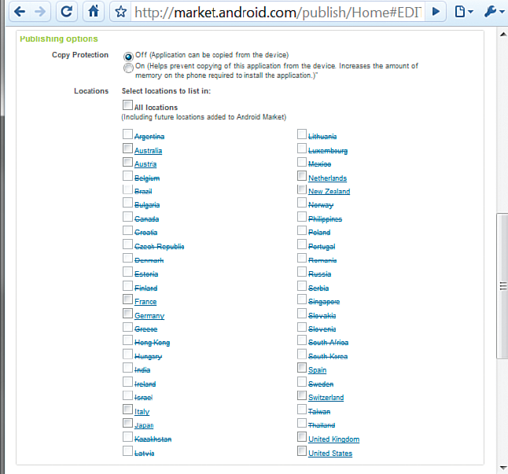
The screen allowing the developer to choose which countries to ship the application to. All countries that do not allow paid applications to be exported to are disabled.

Slide 17
The following is some of the information you must enter on this form:
Application title and description in several languages - English is the default language.
Countries (locations) where the application will be published - These locations are subject to export compliance laws, so choose your locations carefully. As of this writing, nearly 50 locations are available, and new locations are being added regularly. In addition, you can choose specific carriers for each location to further limit application distribution. Alternatively, you can choose All Locations to include any future locations supported by the market. For a complete list of locations where Android applications can be sold or published for free, see http://market.android.com/support/bin/
answer.py?hl=en&answer=138294.
Application type and category - Spend the time to set these fields appropriately, as defined by the Android Market, so that your application reaches its intended audience. Incorrectly categorized applications do not sell well.

Slide 18
Application price - The Android Market currently supports only one pricing model: single payment. No subscription model pricing exists yet within the Android Market. You must find other mechanisms in you’re interested in recurring payment pricing. Note that the Android Market currently imposes a
30% transaction fee for hosting applications within the Android Market. Prices can range from $0.99 to $200 USD, and similar ranges are available in euros and UK pounds.
Copy protection information - Choosing this option may help prevent the application from being copied from the device and distributed without your knowledge or permission.
Support contact information - This option defaults to the information you provided for the developer account. You can change it on an app-by-app basis, though, which allows for great support flexibility when you’re publishing multiple applications.
Consent - You must click the checkboxes to agree to the terms of the current (at the time you click) Android Content Guidelines as well as the export laws of the United States, regardless of your location or nationality.

